Slide 1





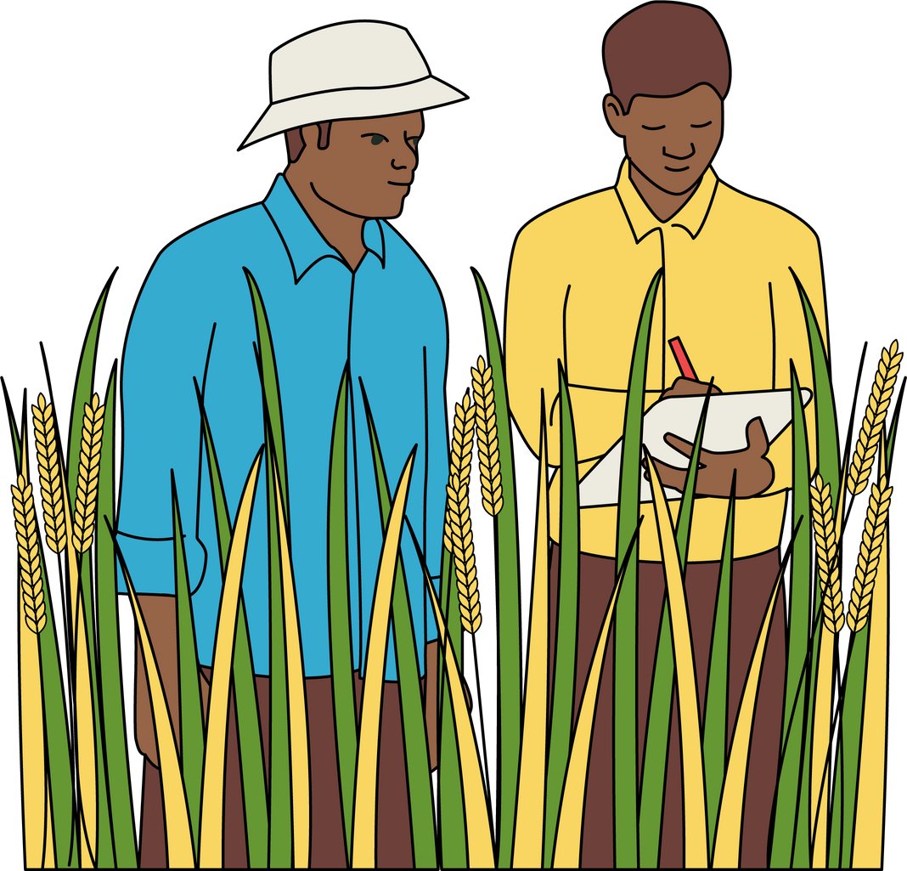
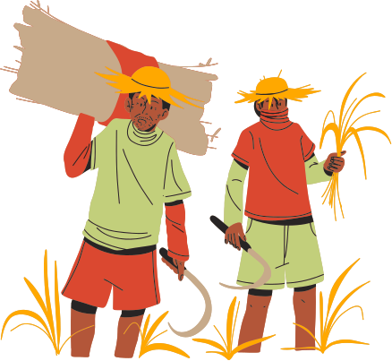
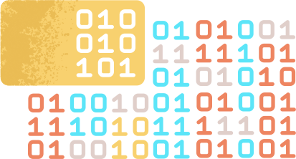

ECOGROW
SMART FARMING APP FOR CLIMATE INFORMED CROP SELECTION USING MACHINE LEARNING
By Achintha Jayatilake

Slide 2
AGENDA
Problem Definition
The Gap Identified with the support of LR
Project’s Aim
Design of the System
Implementation
Demonstration of the software
Results and Achievements
limitations and the future enhancements
Conclusion
01
02
03
04
05
06
07
08
09

Slide 3

PROBLEM DEFINITION
The system is developed for agriculture domain, Targeting the farmers and the people who love to Cultivate,
The problem identified for the farmers in agriculture domain is that they undergo with heavy material loss with no profit and waste of time and energy.
Unpredictable Climate and also without knowing the suitable crops to farm due to the farming Location.

Slide 4




THE GAP IDENTIFIED WITH THE SUPPORT OF LR
Main feature of the system is Prediction of the Climate and Suggesting the most suitable Crops.
The climate prediction is highly important to the farmers
The system is used only 19 Sri Lankan Crops with the plan of adding future crops
Several research gaps were identified during the development of the EcoGrow app
Existing Projects | EcoGrow
Quality of existing literature and solutions are lower. Predict Only by One Machine learning Model, (Dahiphale et al., 2023) some projects Uses IOT to Predict – which hard for users to input valid data (Chana et al., 2023) | I used a Collection of Machine learning Models, which is a Hybrid model User friendly Google Map The Research gap novelty of the EcoGrow ,Crop Recommend system my dataset I have grouped all crops into Terms

Slide 5


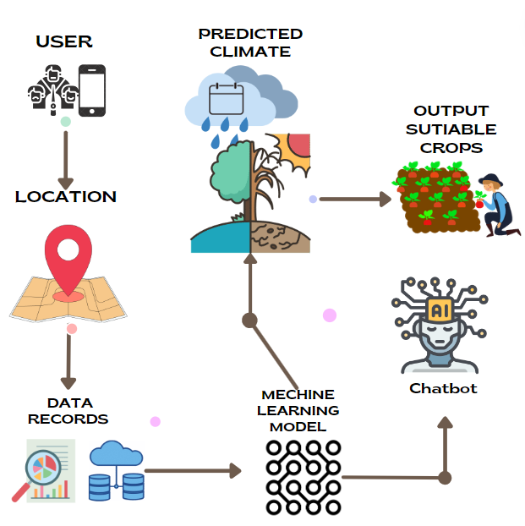
ECOGROW’S AIM
In scope
Development of the EcoGrow smartphone application
Real Time Loctation Tracking
Implementation of a chatbot
Performing machine learning techniques
Development of a simple to use user experience
EcoGrow app prototype comes throughout testing and validation
Out scope
Large scale data collection
Accurate climate modeling
Long-term maintenance and support of the EcoGrow app

Slide 6
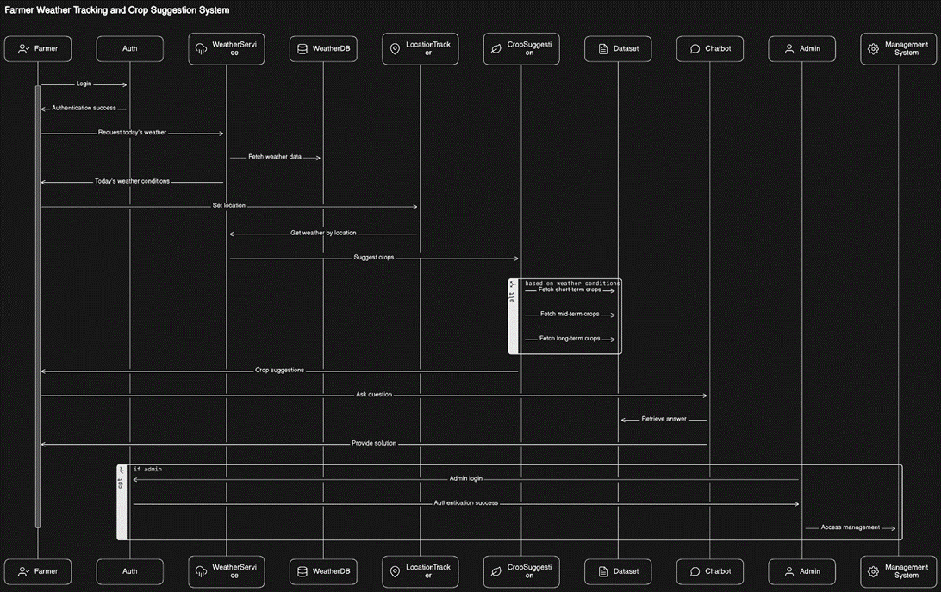

ECOGROW-LAYERED ARCHITECTURE
·User Interface Layer:
This layer represents the mobile application interfaces that users interact with. It includes components for viewing weather information, receiving crop recommendations, and interacting with the chatbot.
·Application Layer:
The application layer contains the core business logic of the Agricultural Assistance App. It encompasses modules for crop recommendation generation, chatbot interactions, user authentication, and other essential functionalities.
·Data Access Layer:
This layer facilitates communication between the application layer and the database layer. It manages the connectivity to the database, retrieval of data, and interaction with the data storage components.
·Database Layer:
The database layer stores critical data, including real-time weather data, user information, and historical records. It ensures efficient data storage and retrieval to support the app's functionalities.

Slide 7
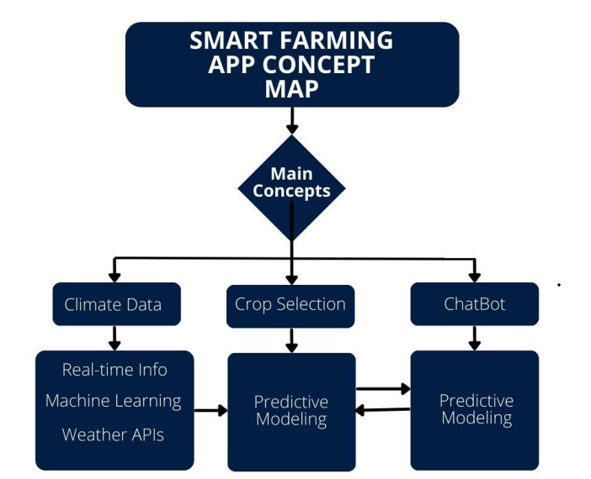


CONCEPT MAP

Slide 8
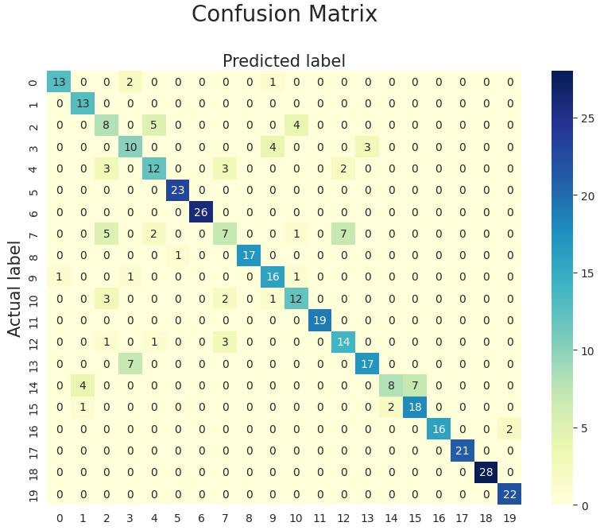
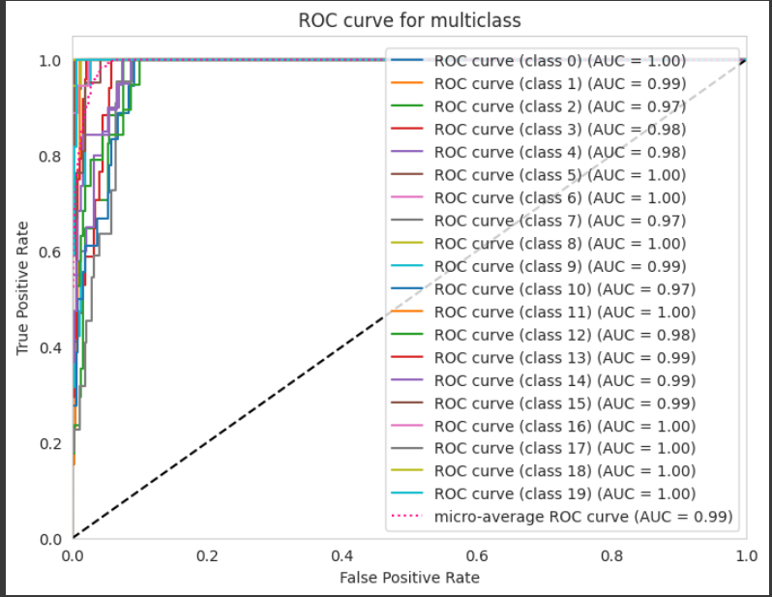
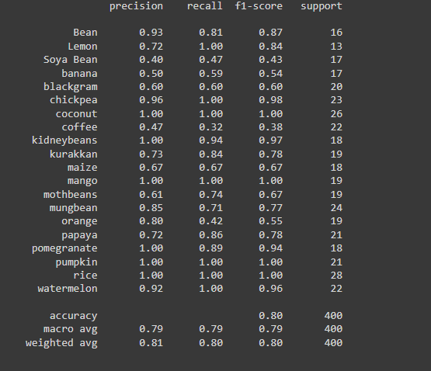


ML Model Testing
visualizing the model's performance
The Area Under the Curve (AUC) of the Receiver Operating Characteristic (ROC) curve
measures the model's ability to distinguish between different classes. A higher AUC value indicates better predictive performance.

Slide 9

PROJECT IMPLEMENTATION

Slide 10




EVALUATION AND FUTURE WORK
01
All Functionality Requirements are Successful implemented
Integration of Soil Analysis Features
Inclusion of Pest Management Tools
Improvement of Scalability and Performance
Enhancement of User Experience
Incorporation of Advanced Analytics
Integration of IoT Devices
02

Slide 11






CONCLUSION
A.NEW SKILLS ACQUIRED
B.USE OF EXISTING SKILLS
C.PROBLEMS AND CHALLENGES FACED
D.CONTRIBUTION TO THE BODY OF KNOWLEDGE

Slide 12









REFERENCES
DAHIPHALE, D., SHINDE, P., PATIL, K., DAHIPHALE, V., 2023. SMART FARMING: CROP RECOMMENDATION USING MACHINE LEARNING WITH CHALLENGES AND FUTURE IDEAS (PREPRINT). https://doi.org/10.36227/techrxiv.23504496.v1
XWeather. (n.d.). XWeather API. Retrieved from https://www.xweather.com/weather-api?gclid=CjwKCAiA8YyuBhBSEiwA5R3Ey88SUZSY1itHy2Wipw8mWS9fPAJOV4WD2GwcIoXcOtXPVJDJFB7dxoCecgQAvD_BwE
Meteomatics. (n.d.). Best Weather APIs. Retrieved from https://www.meteomatics.com/en/weather-api/best-weather-apis/#
Planet. (n.d.). Planetary Variables. Retrieved from https://www.planet.com/products/planetary-variables/?utm_source=google&utm_campaign=evr-product&utm_content=pros-leads-pvsearch-0124&utm_medium=paid-search&gad_source=1&gclid=CjwKCAiA8YyuBhBSEiwA5R3-EzogiMWqDKWRHbKdBlrdjjApifumptub6GdezVSuiPJPHaIVjn818xoCX_UQAvD_BwE
Agronomy Society of America. (n.d.). Publications. Retrieved from https://www.agronomy.org/publications?gad_source=1&gclid=CjwKCAiA8YyuBhBSEiwA5R3-E3hUe4Bj4m_Mp6PmHUnksPrMpP1EhCYfpfvg2GeA_a2nzKrA8KrA7BoCgHAQAvD_BwE
Bioversity International. (n.d.). Central crop databases. Retrieved from https://www.ecpgr.cgiar.org/fileadmin/bioversity/publications/pdfs/351_Central_crop_databases.pdf
Springer. (n.d.). Article. Retrieved from https://link.springer.com/article/10.1007/s42979-021-00592-x
National Center for Biotechnology Information. (n.d.). Article. Retrieved from https://www.ncbi.nlm.nih.gov/pmc/articles/PMC10171456/
ResearchGate. (n.d.). Agribot: A Natural Language Generative Neural Networks Engine for Agricultural Applications. Retrieved from https://www.researchgate.net/publication/340975217_Agribot_A_Natural_Language_Generative_Neural_Networks_Engine_for_Agricultural_Applications
GeeksforGeeks. (n.d.). Top Mobile App Development Frameworks. Retrieved from https://www.geeksforgeeks.org/top-mobile-app-development-frameworks/
Appinventiv. (n.d.). Mobile App Development Frameworks. Retrieved from https://appinventiv.com/blog/mobile-app-development-frameworks/
Bacancy Technology. (n.d.). Mobile App Development Frameworks. Retrieved from https://www.bacancytechnology.com/blog/mobile-app-development-frameworks
Akvo. (n.d.). Agriculture. Retrieved from https://akvo.org/agriculture/?utm_term=digital%20agriculture&utm_campaign=&utm_source=adwords&utm_medium=ppc&hsa_acc=7028243667&hsa_cam=18804281185&hsa_grp=161426399001&hsa_ad=688096262531&hsa_src=g&hsa_tgt=kwd-300382343965&hsa_kw=digital%20agriculture&hsa_mt=b&hsa_net=adwords&hsa_ver=3&gclid=CjwKCAiA8YyuBhBSEiwA5R3-EwMtBJcfiNdJpn9LA1pgVSvWH4O8mBdAa0Li5nBnz79DWkGpR6ul7xoC2n0QAvD_BwE&gad_source=1
Chana, A.M., Batchakui, B., Nges, B.B., 2023. Real-Time Crop Prediction Based on Soil Fertility and Weather Forecast Using IoT and a Machine Learning Algorithm. Agricultural Sciences 14, 645–664. https://doi.org/10.4236/as.2023.145044
Ratnayake, S.S., Kariyawasam, C.S., Kumar, L., Hunter, D., Liyanage, A.S.U., 2021. Potential distribution of crop wild relatives under climate change in Sri Lanka: implications for conservation of agricultural biodiversity. Current Research in Environmental Sustainability 3, 100092. https://doi.org/10.1016/j.crsust.2021.100092

Slide 13

THANK YOU!

